Slide 1
Presentation
North Western University
Name: Sajib Bhattacharjee
Id:20201070010
Presentation Name: The History of Emergence of Independent Bangladesh.
Department: CSE
Section- B

Slide 2
Six point movement:
The 6 point movement was a bengali nationalist movement in east pakistan spearheaded by sheikh mujibur rahman, which eventually led to the liberation of bangladesh. The movement's main agenda was to realize the six demands put forward by a coalition of bengal nationalist political parties in 1966, to end the perceived exploitation of east pakistan by the west pakistani rules.
Debates exist on the authorship of the six points. In 1966, the then bhashani NAP, pro-china communist groups and chhatra union (menon group) were the first to articulate their reaction. They claimed that the six points were in fact the creation of the CIA. Its aim was to develop rapport with the USA by creating problems for ayub khan. But such an explanation on the origin of 6 points was not accepted or proved by anyone later.

Slide 3
Some people opine that the six points were in fact the creation of some bengali CSP officers – ruhul quddus, shamsur rahman khan, ahmed fazlur rahman. A segment of the people are of the view that the six points were the joint production of intellectuals including the economics professors of dhaka university.
Alongside this, others believe that the six points were prepared by a group of leftist politicians of india.
There was another segment who used to claim that ayub khan used his favorite bureaucrat altaf gauhar to prepare the document and then handed that over to khairul kabir (the then general manager of krishi bank). His goal was to elicit political dividends.
Because of these contradictory claims and contrary views regarding the drafting of six points, its origin still remains unclear and shrouded in mystery.

Slide 4
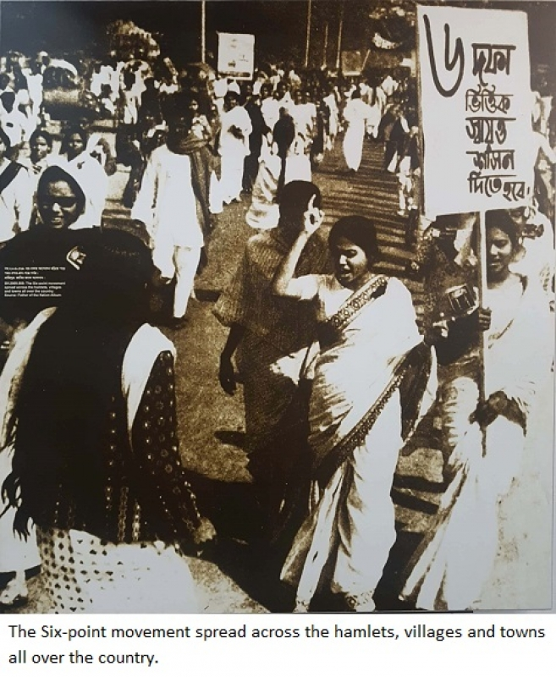

Slide 5
The 6 points:
The six points are noted as being:
The constitution should provide for a federation of pakistan in its true sense based on the lahore resolution and the parliamentary form of government with supremacy of a legislature directly elected on the basis of universal adult franchise.
The federal government should deal with only two subjects: defense and foreign affairs, and all other residual subjects should be vested in the federating states.
Two separate, but freely convertible currencies for two wings should be introduced; or if this is not feasible, there should be one currency for the whole country, but effective constitutional provisions should be introduced to stop the flight of capital from east to west pakistan. Furthermore, a separate banking reserve should be established and separate fiscal and monetary policy be adopted for east pakistan.

Slide 6
The power of taxation and revenue collection should be vested in the federating units and the federal center would have no such power. The federation would be entitled to a share in the state taxes to meet its expenditures.
There should be two separate accounts for the foreign exchange earnings of the two wings; the foreign exchange requirements of the federal government should be met by the two wings equally or in a ratio to be fixed; indigenous products should move free of duty between the two wings, and the constitution should empower the units to establish trade links with foreign countries.
East pakistan should have a separate militia or paramilitary force.

